Slide 1
UCM Upsilon Pi Epsilon
Git Workshop
University of Central Missouri, Fall 2024

Slide 2
Git History
Created by Linus Torvalds, creator of Linux, in 2005
Came out of Linux development community
Designed to do version control on Linux kernel
Goals of Git:
Speed
Support for non-linear development (thousands of parallel branches)
Fully distributed
Able to handle large projects efficiently
(A "git" is a cranky old man. Linus meant himself. I would agree with that assessment)

Slide 3
Other Version Control
Git isn’t the only game in town, just the most popular.
Mercurial - Similar to git, used heavily on Python development.
Perforce
Older:
SVN, CVS, Clearcase, RCS

Slide 4
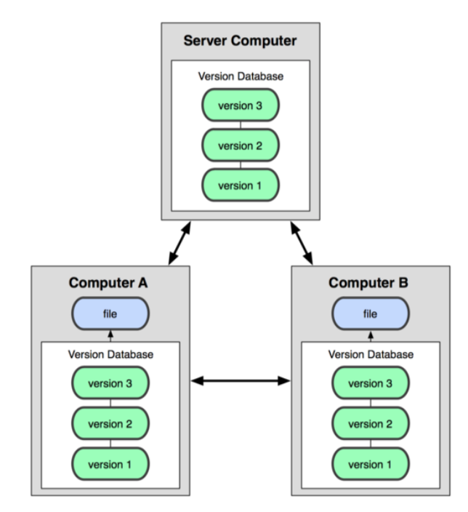
Distributed Version Control
In git, mercurial, etc., you don't "checkout" from a central repo
You "clone" it and "pull" changes from it
Your local repo is a complete copy of everything on the remote server
Yours is "just as good" as theirs
Many operations are local:
Check in/out from local repo
Commit changes to local repo – local repo keeps version history
When you're ready, you can "push" changes back to server
images taken from http://git-scm.com/book/en/

Slide 5
Git Commit IDs
In Git, each user has their own copy of the repo, and commits changes to their local copy of the repo before pushing to the central server.
So Git generates a unique SHA-1 hash (40 character string of hex digits) for every commit.
Refers to commits by this ID rather than a version number.
Often we only see the first 7 characters:
1677b2d Edited first line of readme 258efa7 Added line to readme 0e52da7 Initial commit

Slide 6
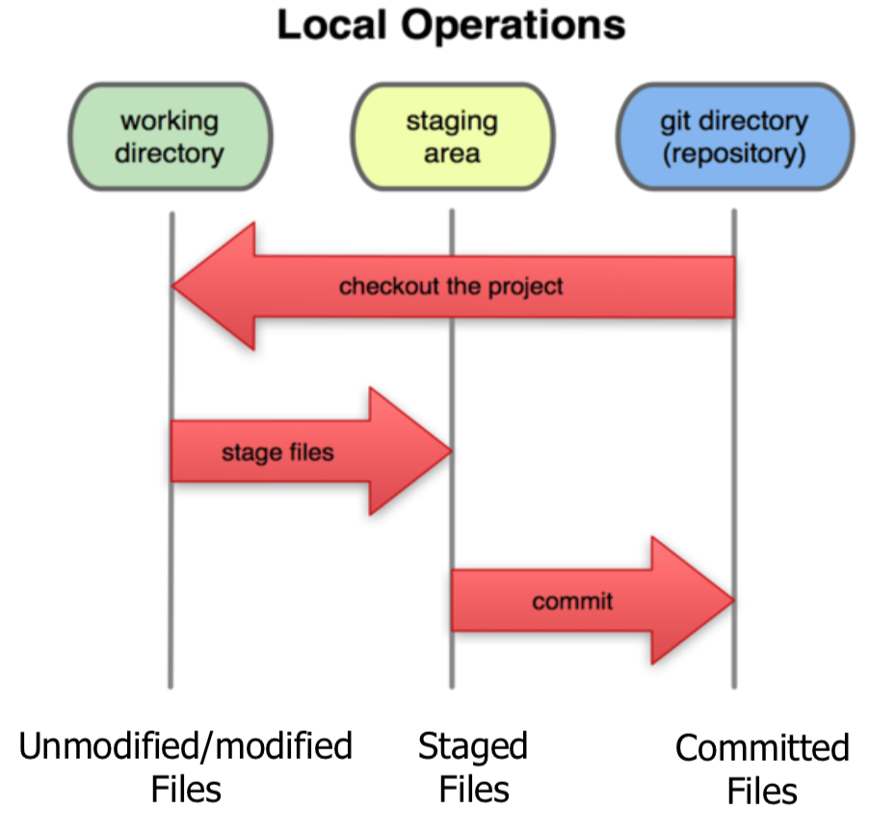
Local Git Areas
In your local copy on git, files can be:
In your local repo
committed
Checked out and modified, but not yet committed
working copy
Or, in-between,
"staging" area
Staged files are ready to be committed.
A commit saves a snapshot of all staged state.
images taken from http://git-scm.com/book/en/

Slide 7
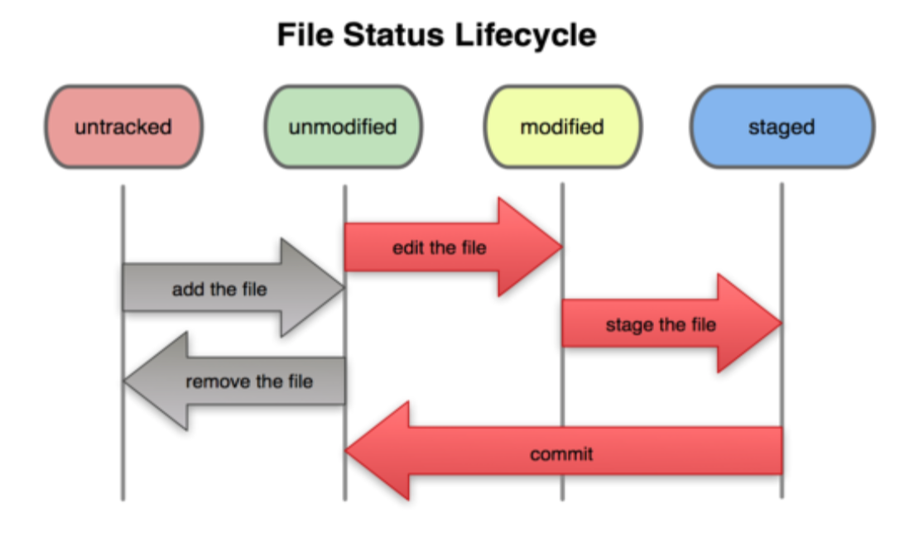
Basic Git Workflow
Modify files in your working directory.
Stage files, adding snapshots of them to your staging area.
Commit, which takes the files in the staging area and stores that snapshot permanently to your Git directory.
images taken from http://git-scm.com/book/en/

Slide 8
Workshop Screenshots

Slide 9
Section 2
Configuration Screenshots

Slide 10
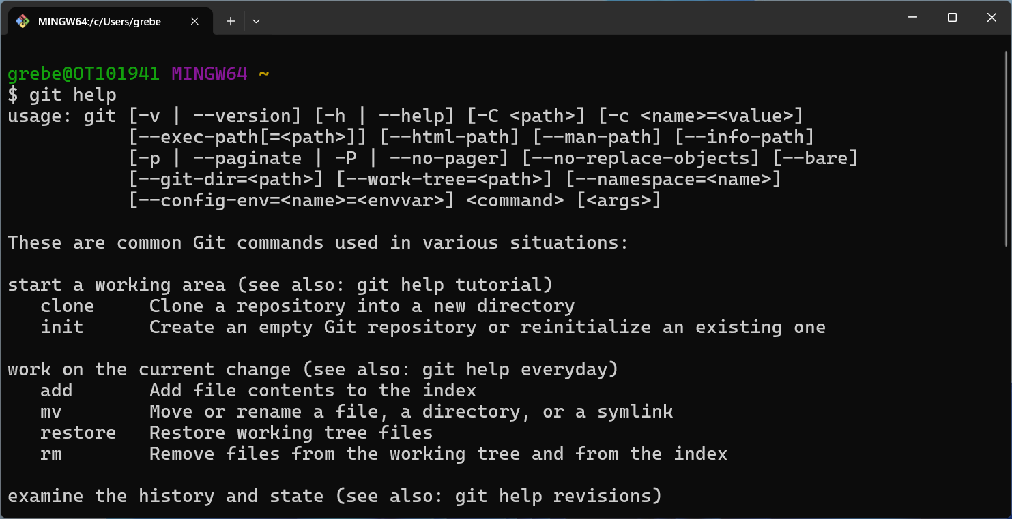
Basic Help

Slide 11
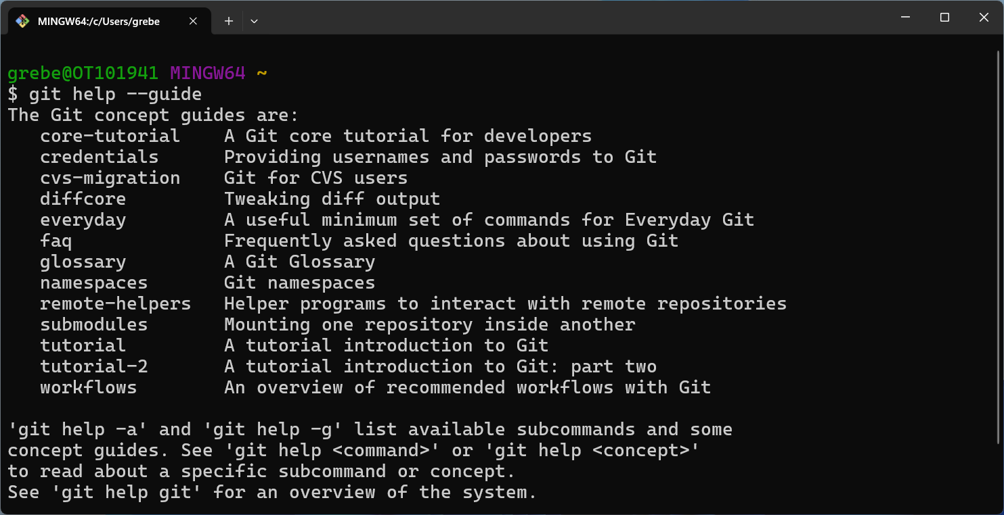
Help Guide

Slide 12
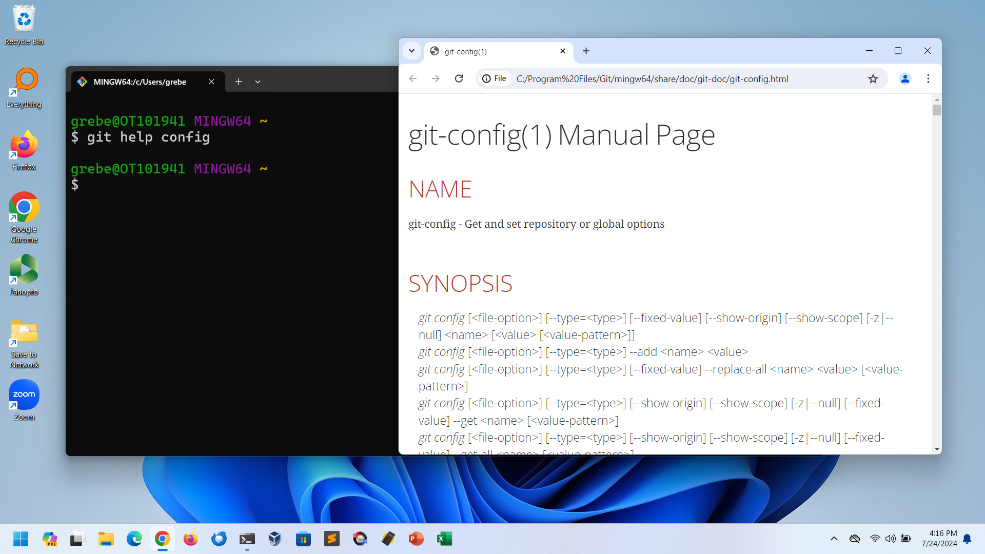
Help Config

Slide 13
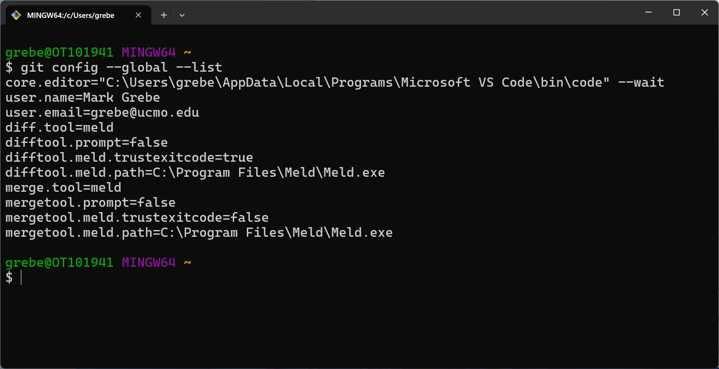
Config List

Slide 14
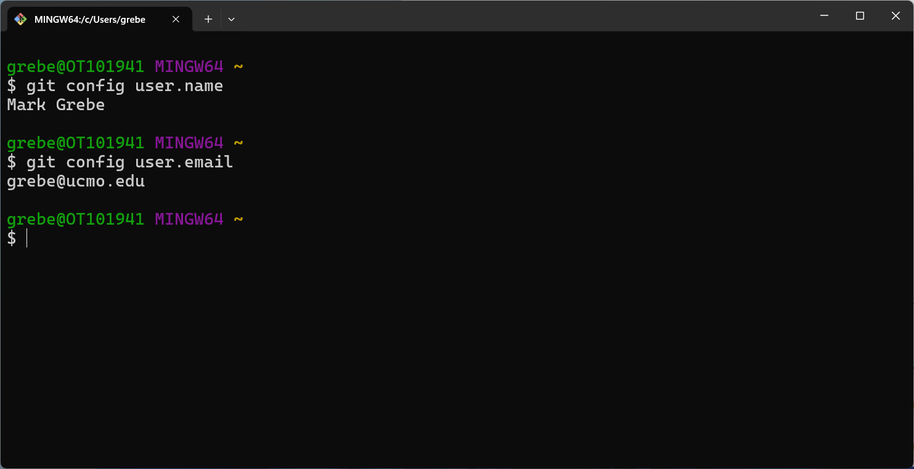
Config User

Slide 15
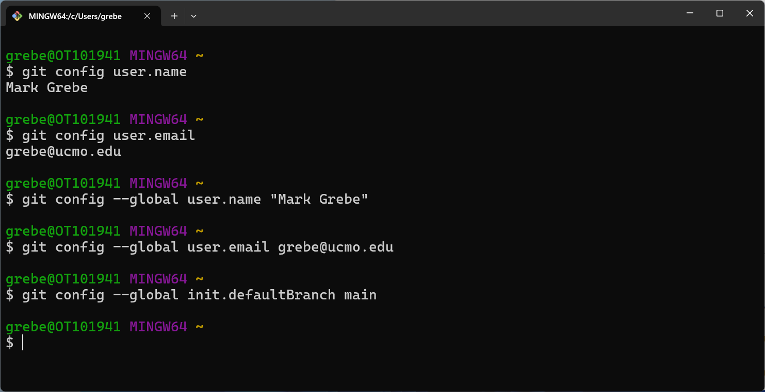
Config Set User

Slide 16
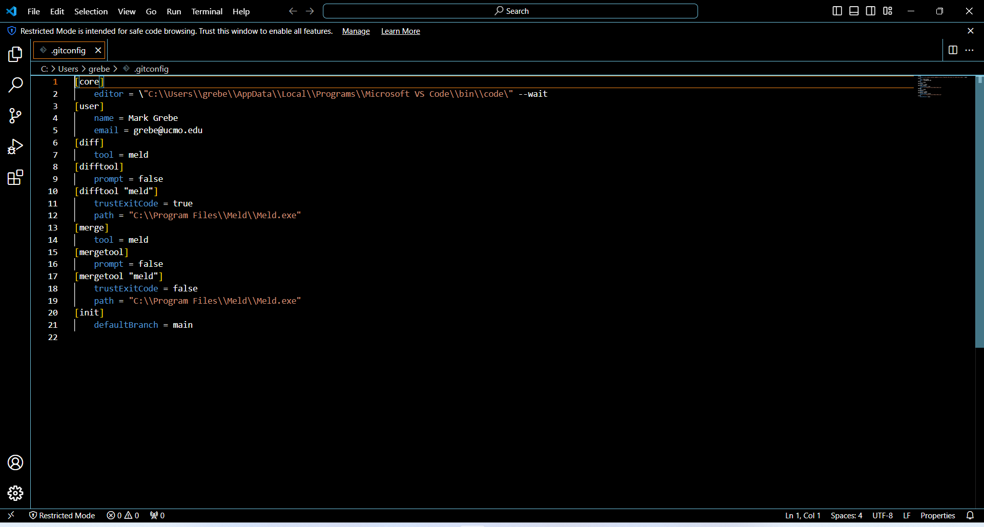
Config Edit in Code

Slide 17
Section 3
Git 101
Screenshots

Slide 18
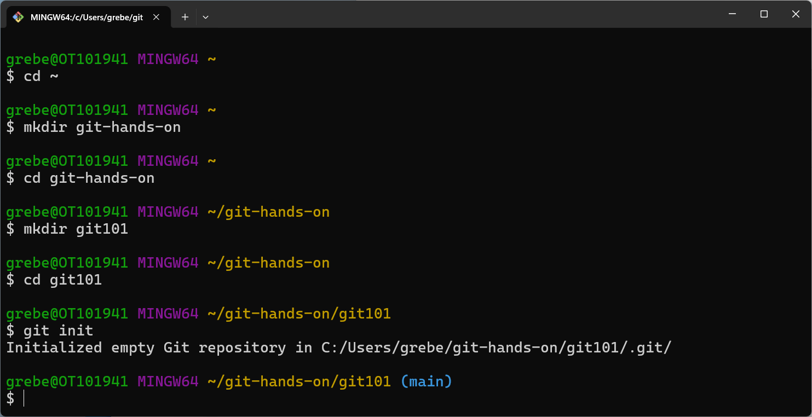
Create 101 Repo

Slide 19
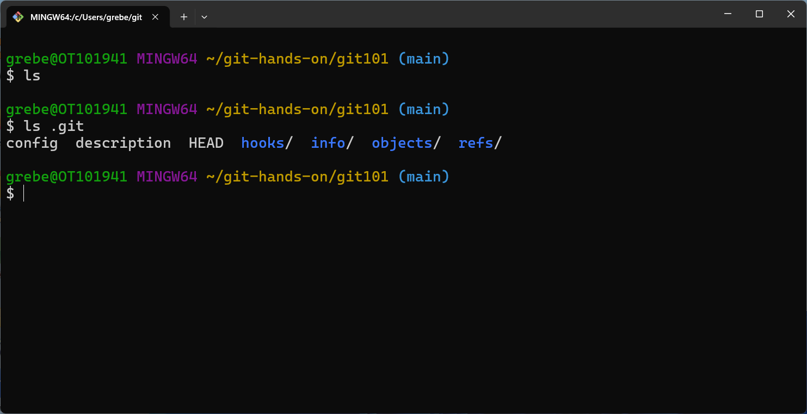
List Git Repo Dir

Slide 20
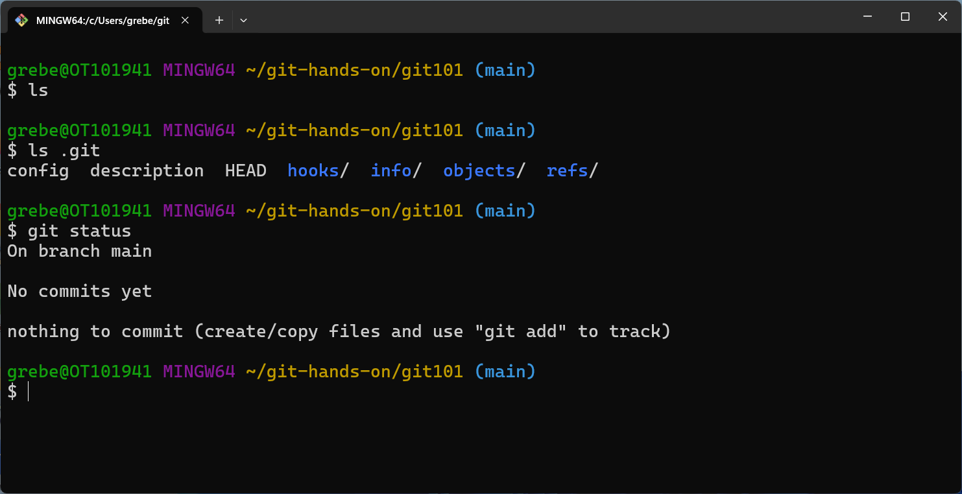
Show Repo Status

Slide 21
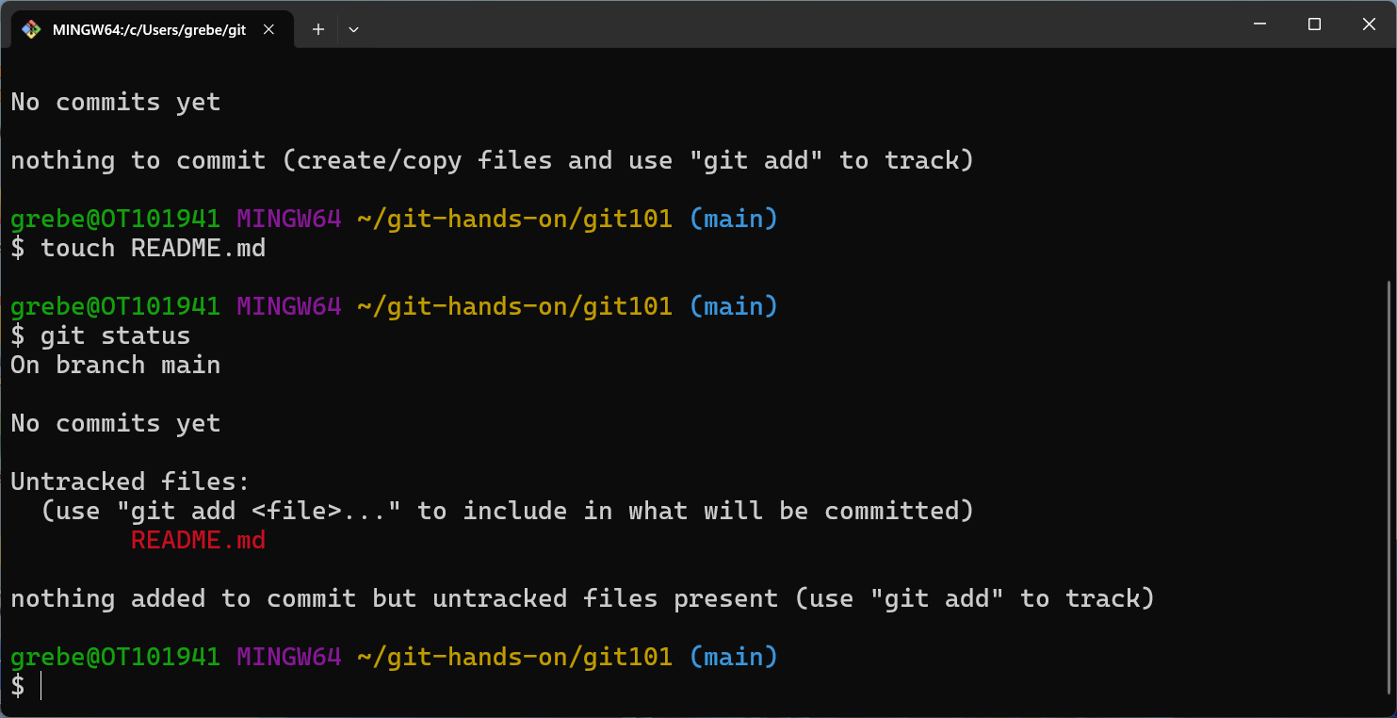
Create Blank Readme

Slide 22
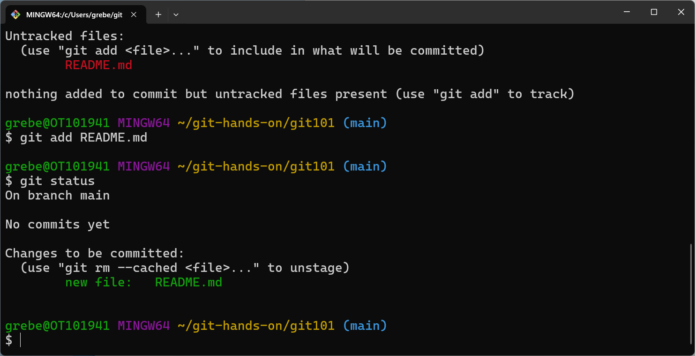
Add Blank Readme

Slide 23
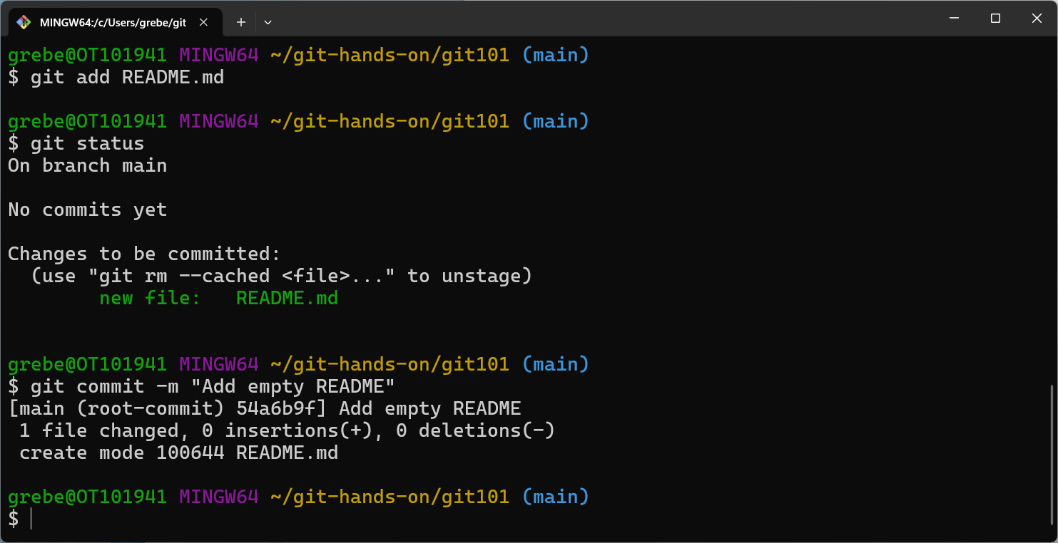
Commit Blank Readme

Slide 24
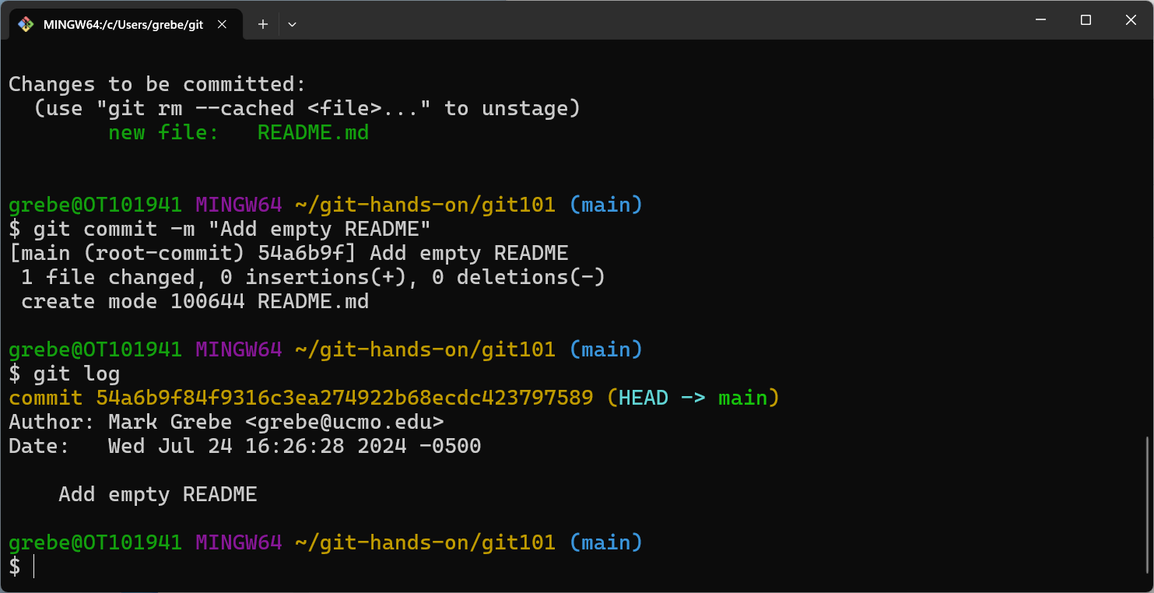
Git Log

Slide 25
Section 4
Clone A Remote Repo
Screenshots

Slide 26
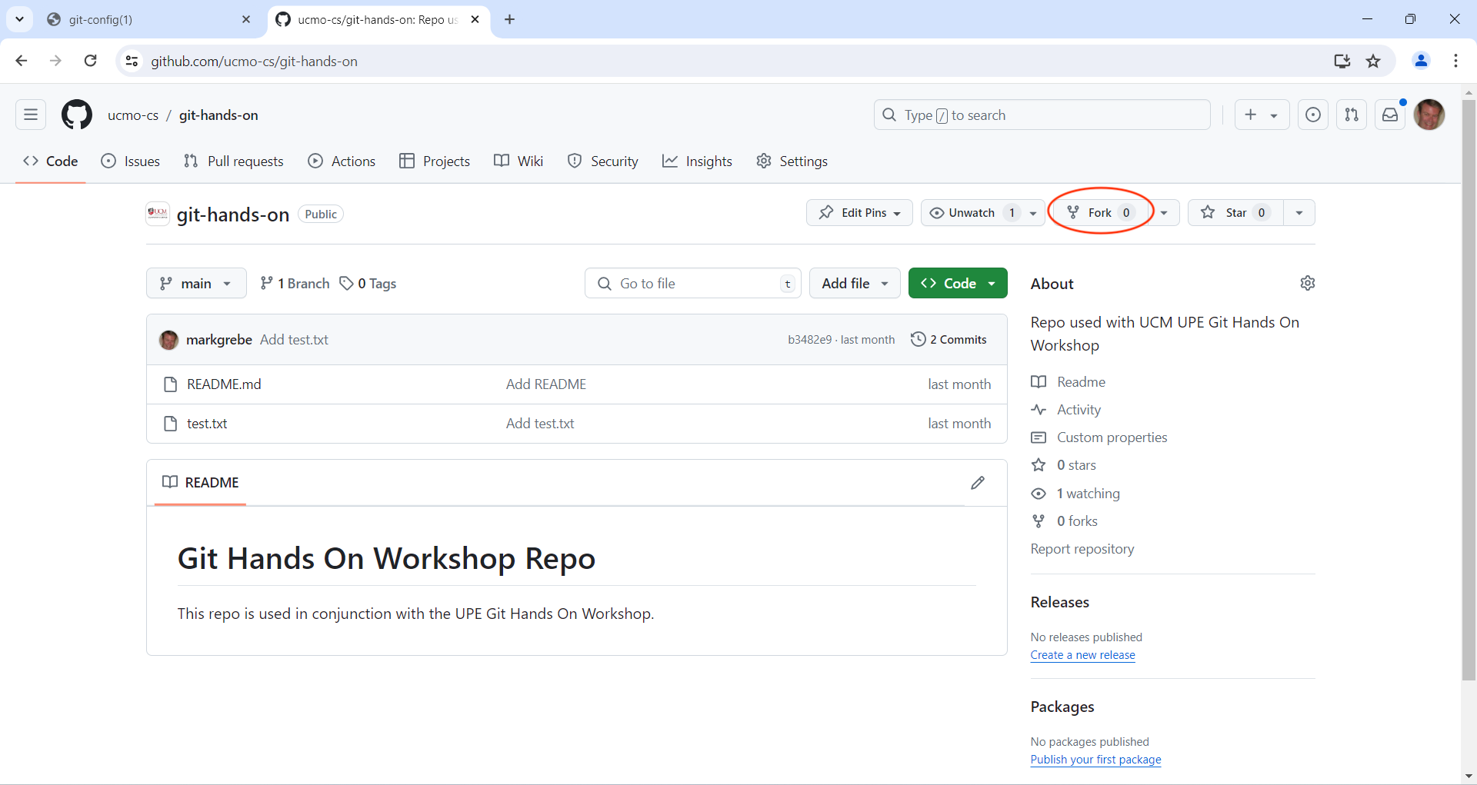
Pull Up Remote Repo

Slide 27
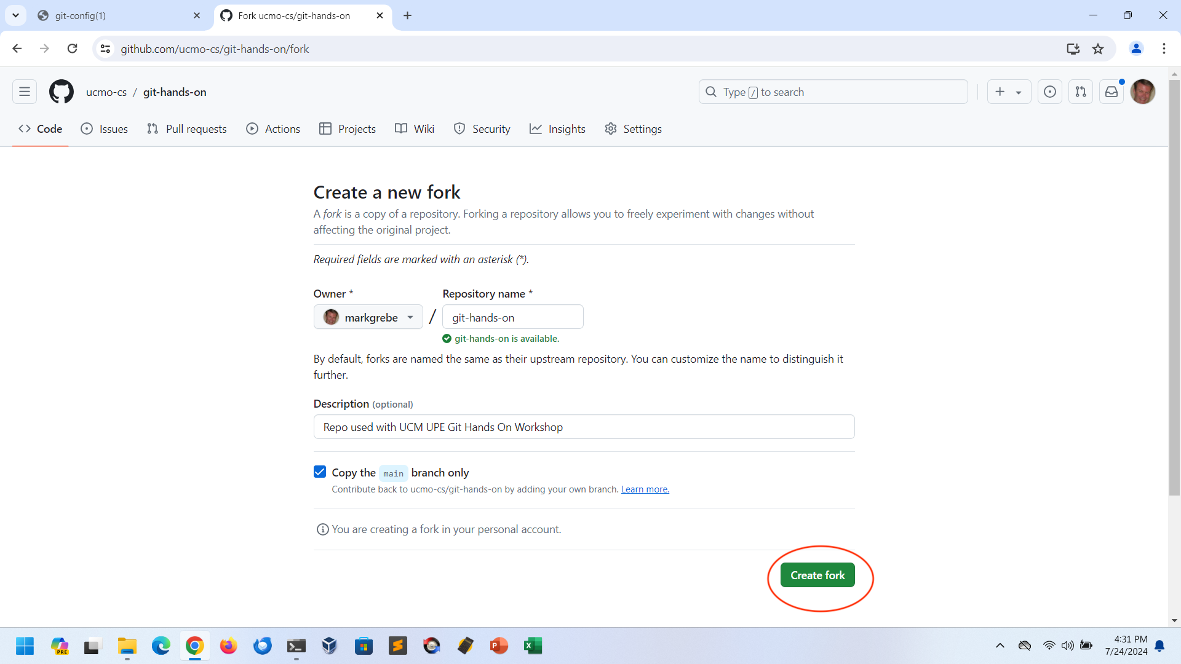
Fork Repo

Slide 28
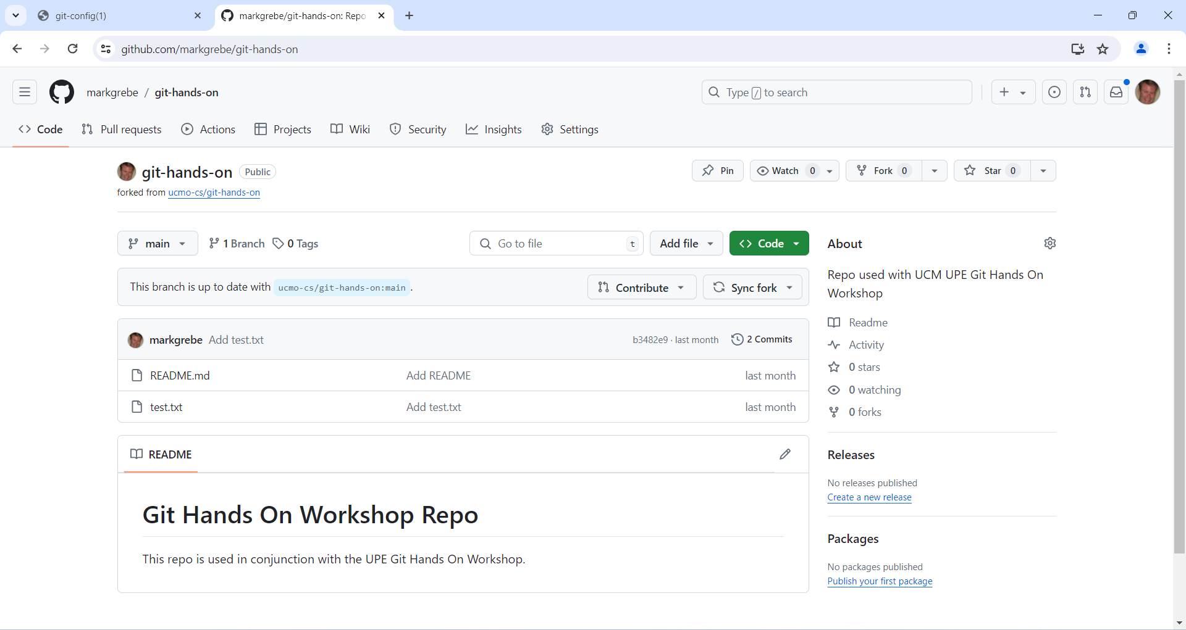
Newly Forked Repo

Slide 29
Section 5
Push To A Remote Repo
Screenshots

Slide 30
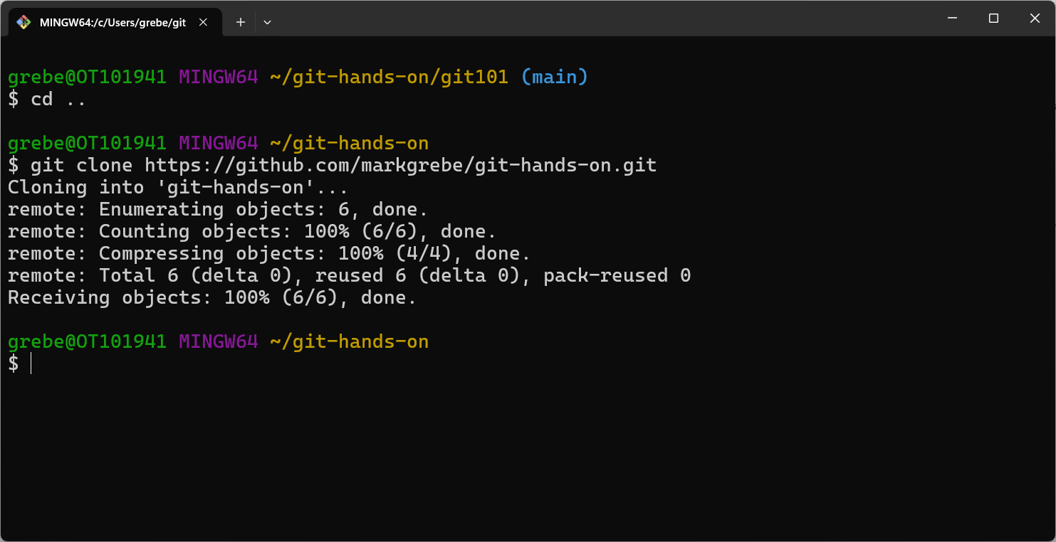
Clone Remote Repo

Slide 31
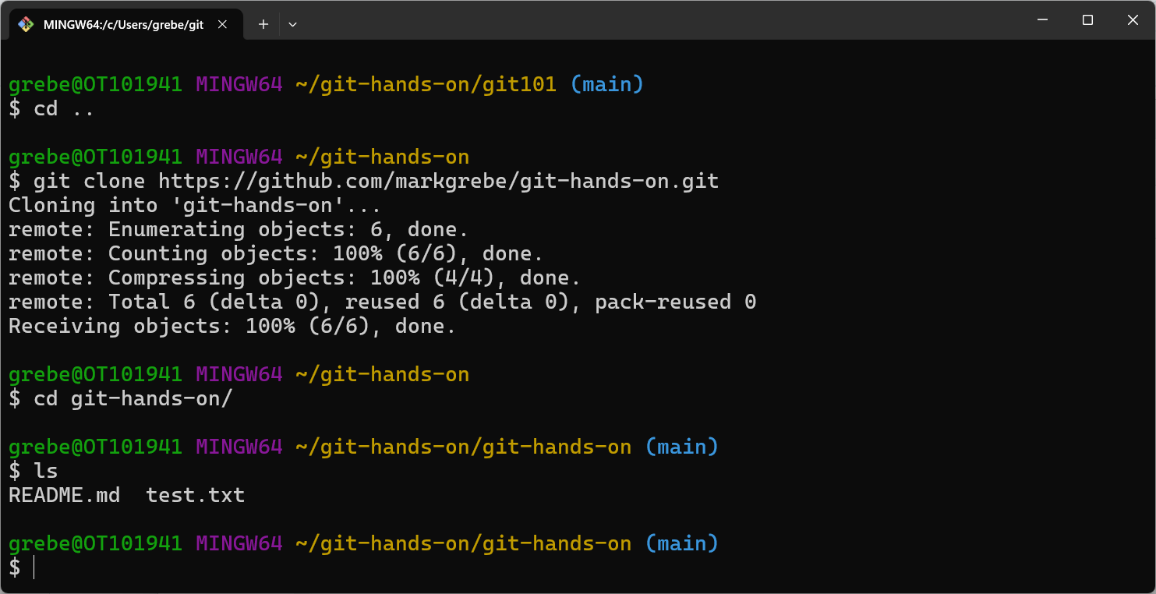
List Cloned Repo

Slide 32
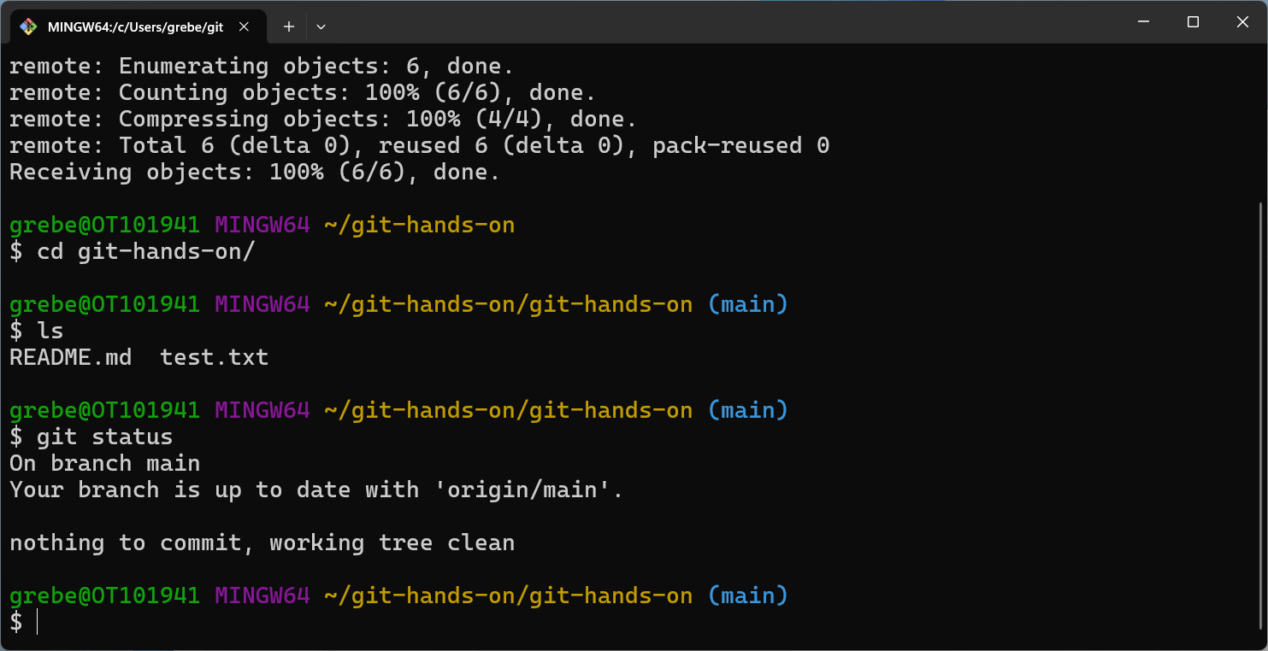
Cloned Repo Status

Slide 33
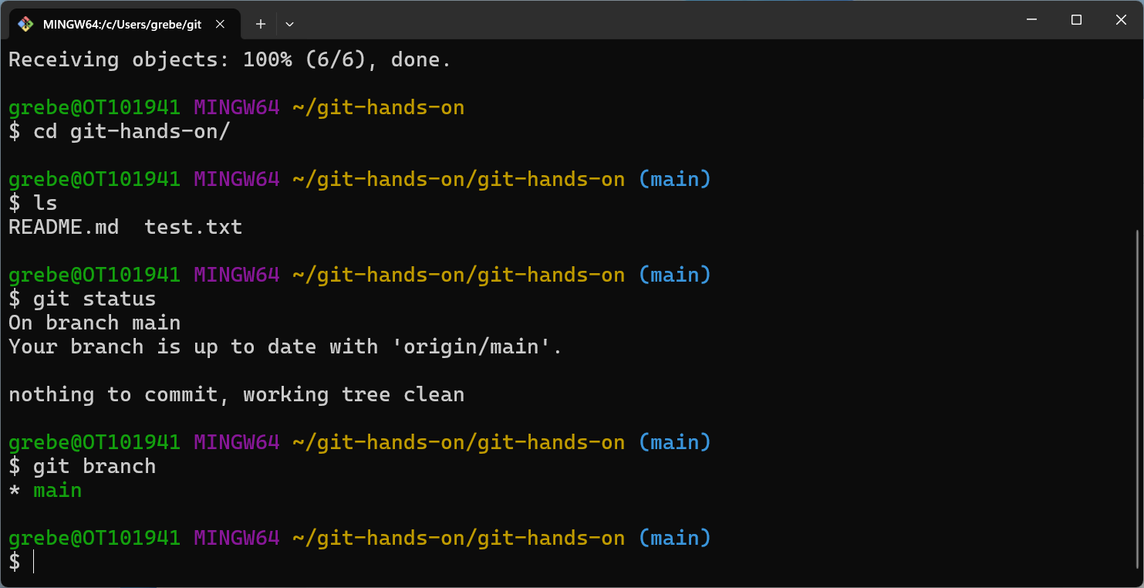
Repo Branches

Slide 34
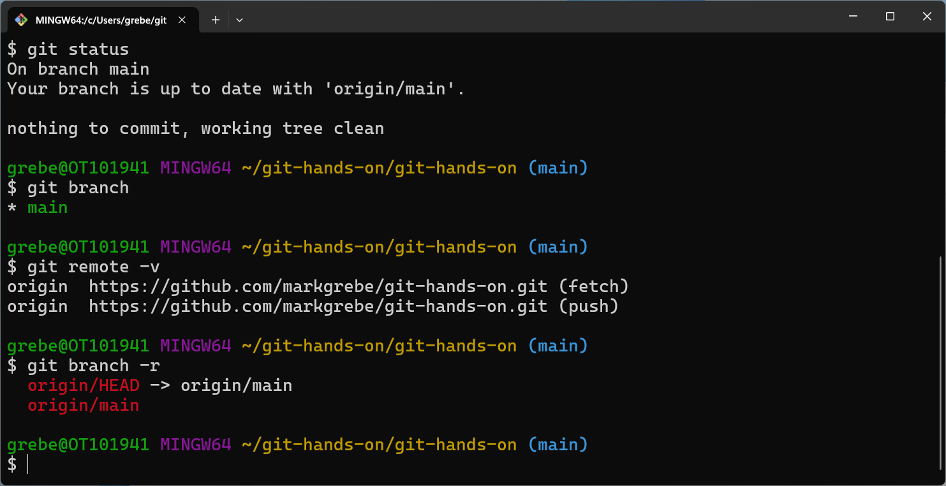
Repo Remotes/Branches

Slide 35
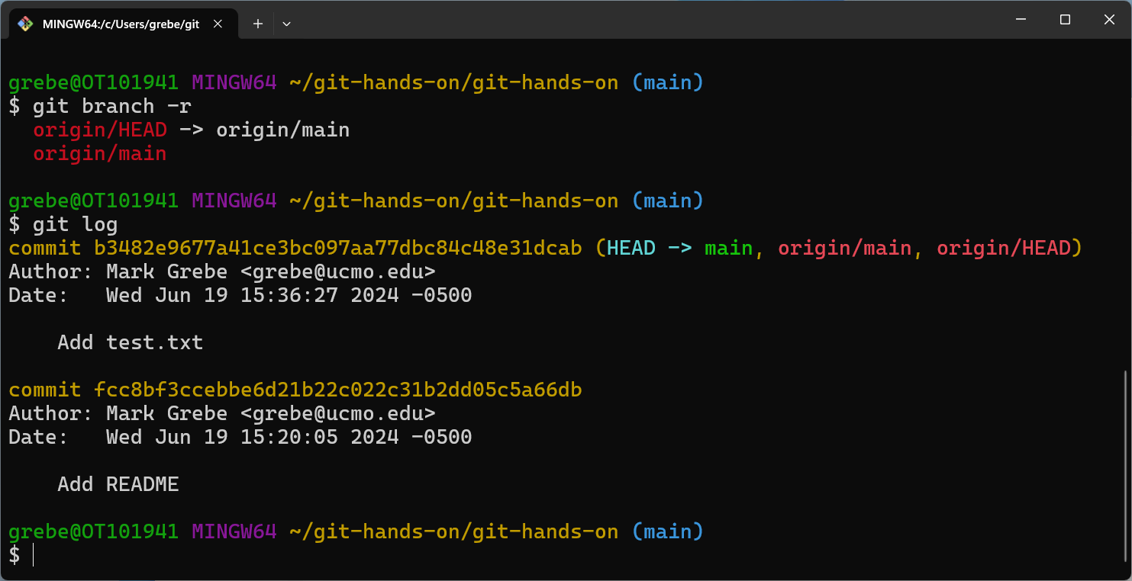
Repo Log

Slide 36
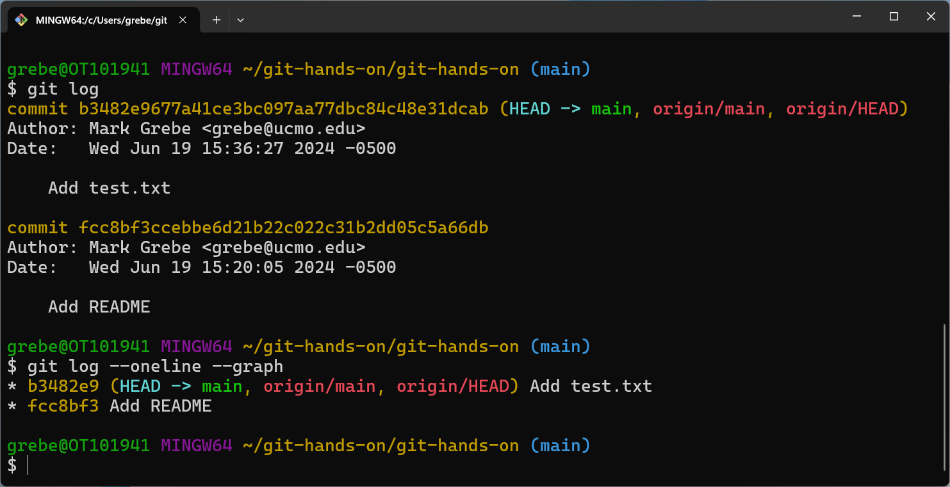
Repo Log One Line

Slide 37
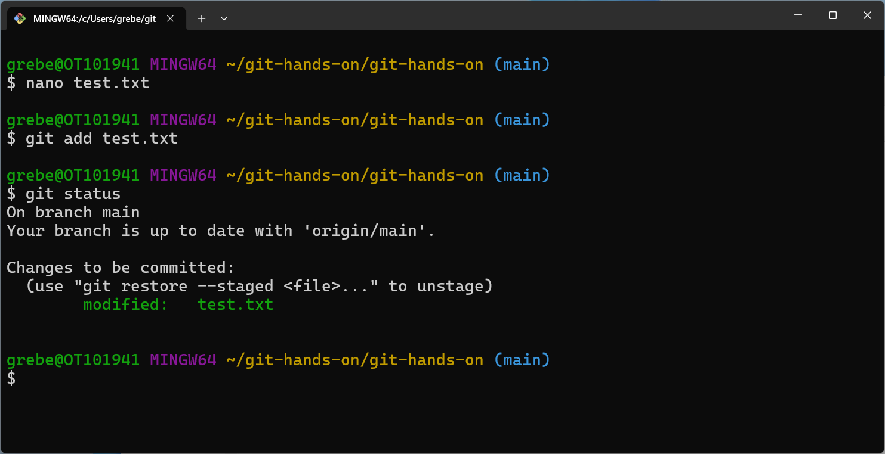
Edit and add test.txt

Slide 38
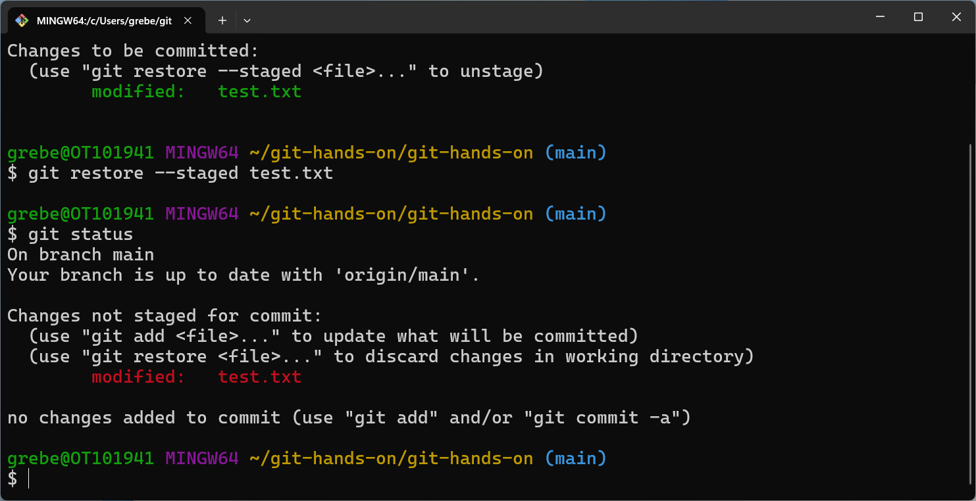
Unstage test.txt

Slide 39
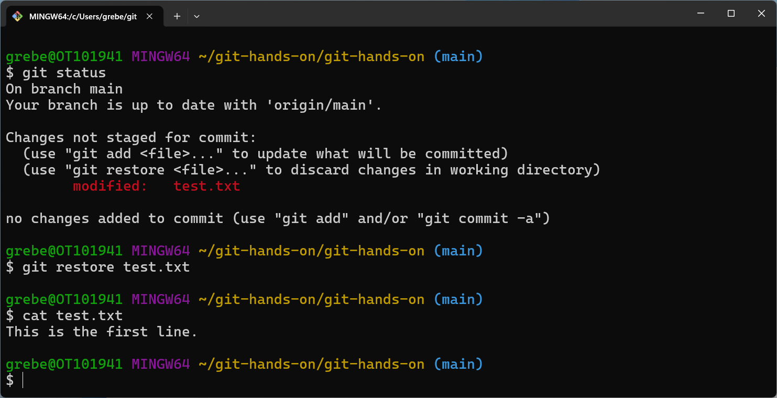
Restore original test.txt

Slide 40
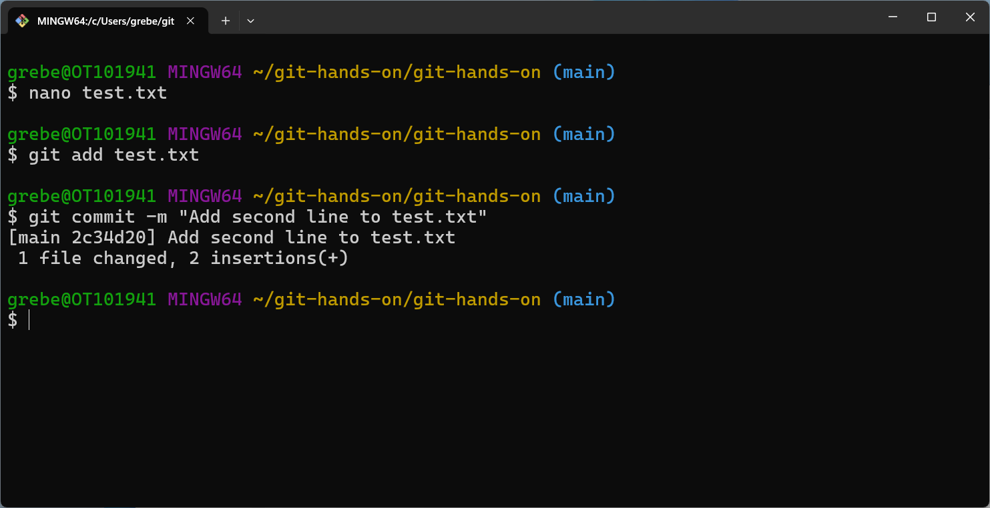
Redo test.txt, add, and commit

Slide 41
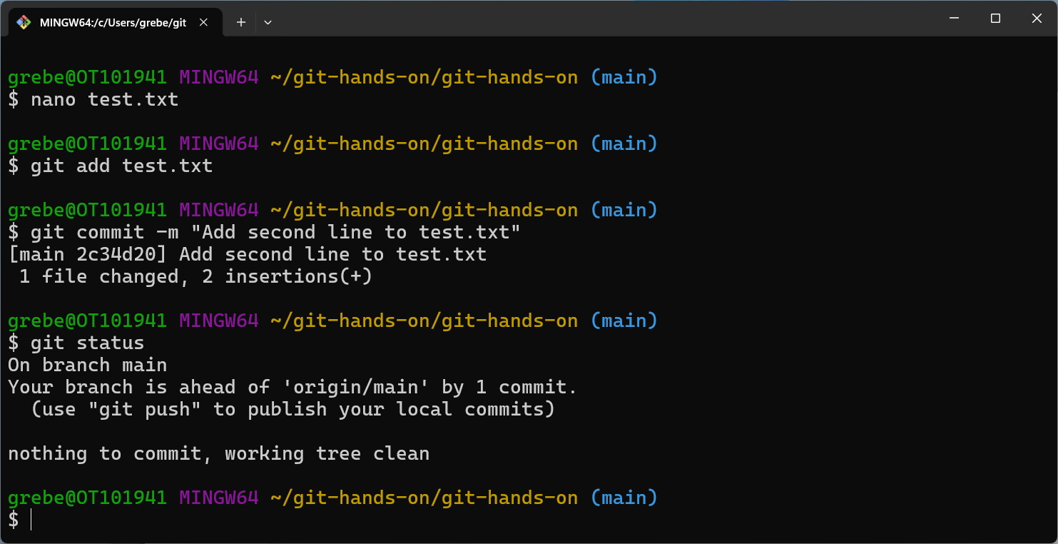
Repo Status

Slide 42
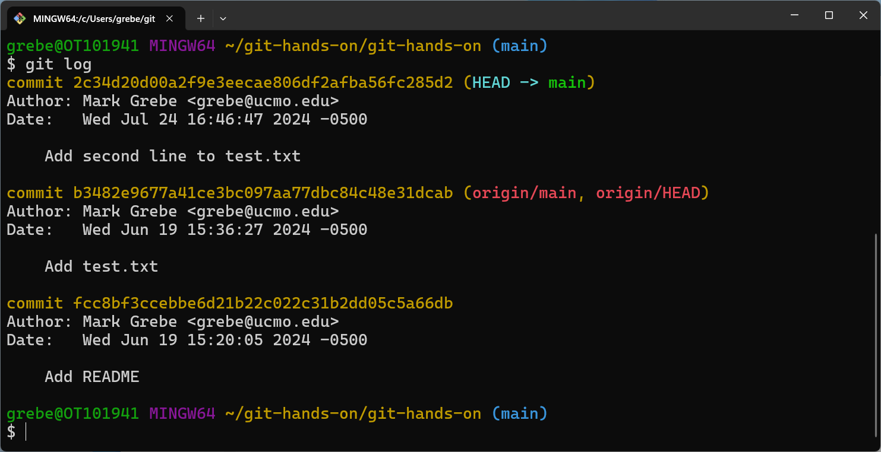
Repo Log

Slide 43
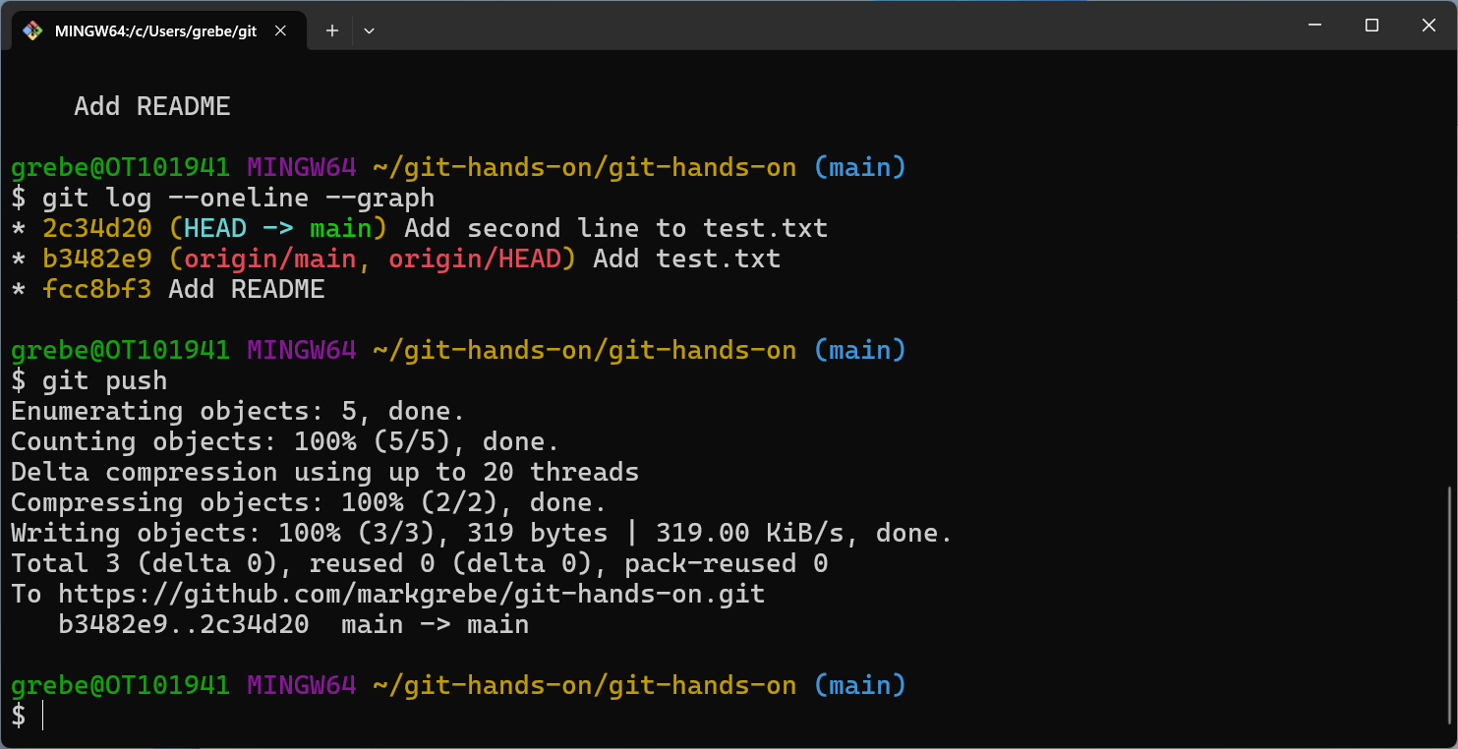
Repo Log and Push to Remote

Slide 44
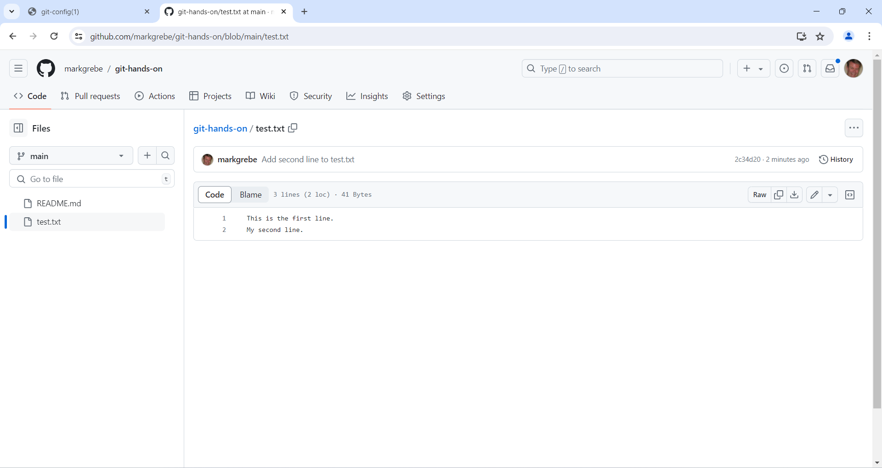
Check File on Remote

Slide 45
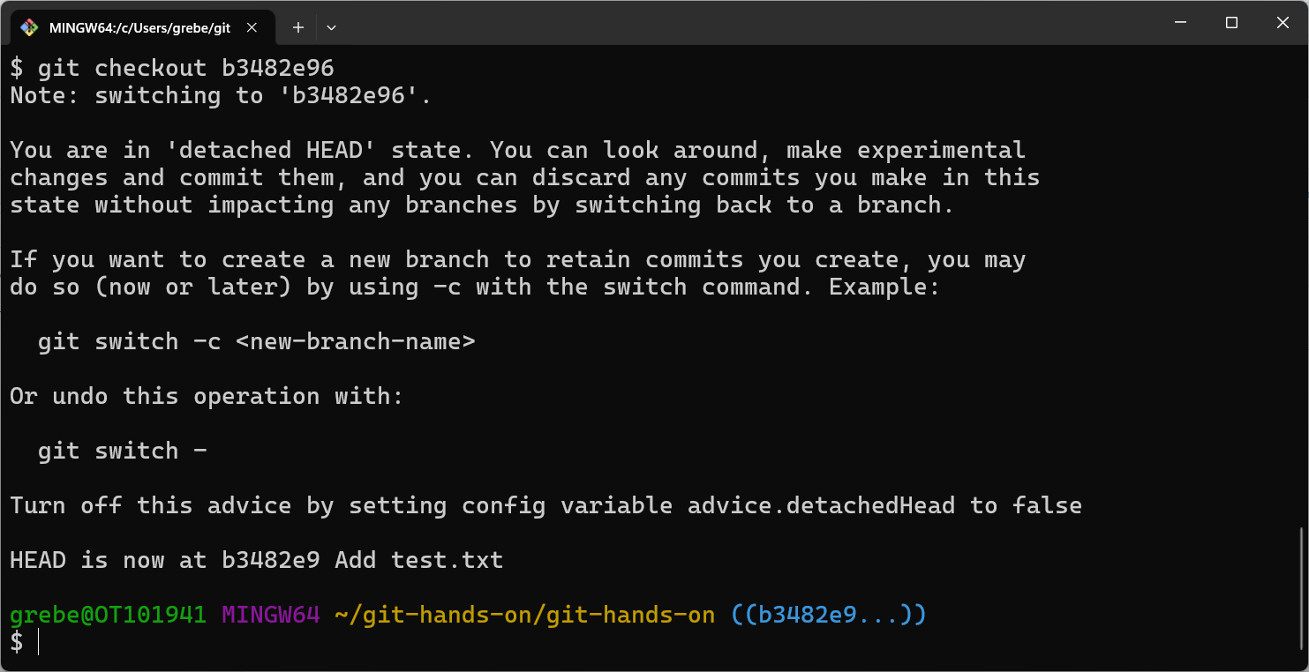
Git Checkout Old Version

Slide 46
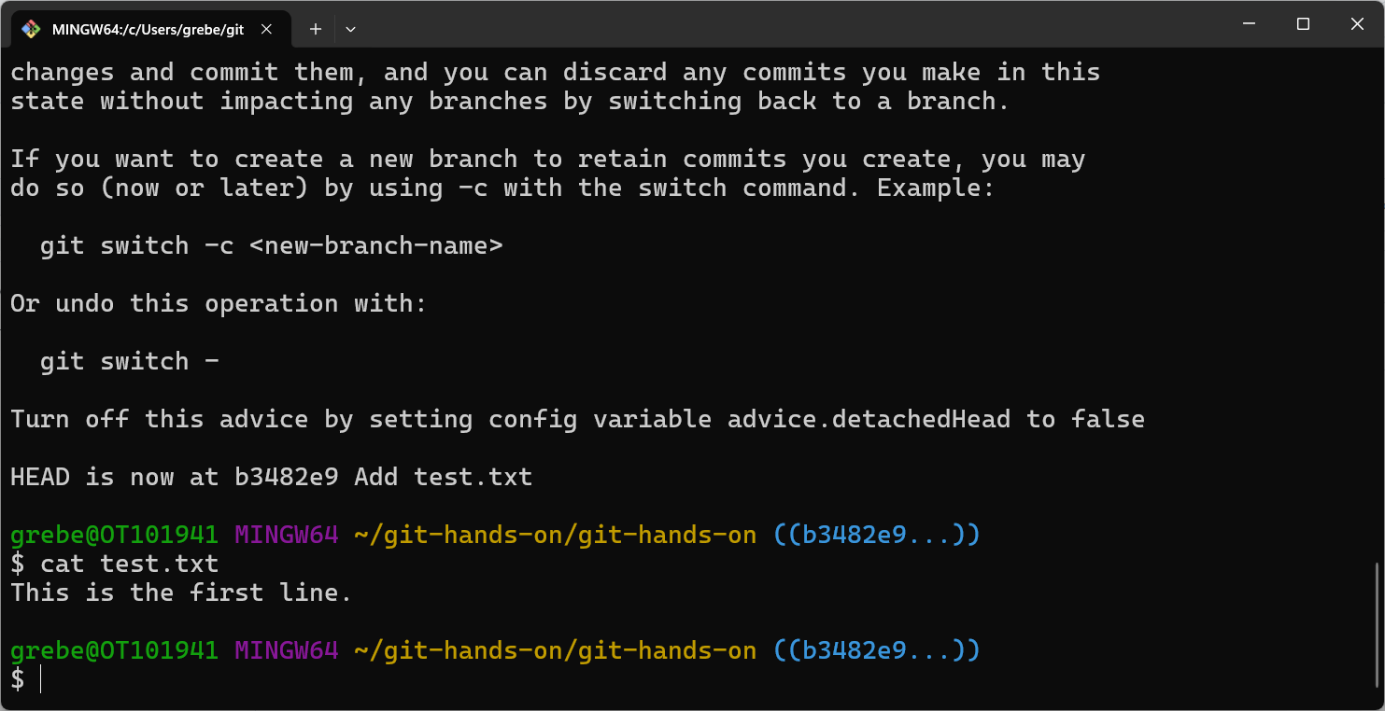
Display Old Version

Slide 47
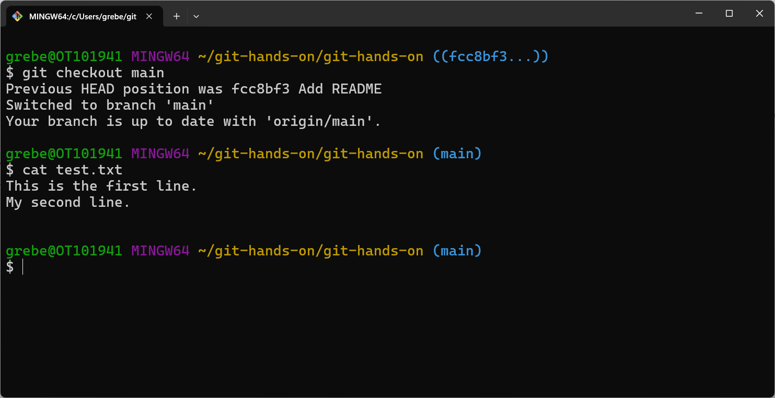
Back to Current Version

Slide 48
Section 6
Working Locally With Branches
Screenshots

Slide 49
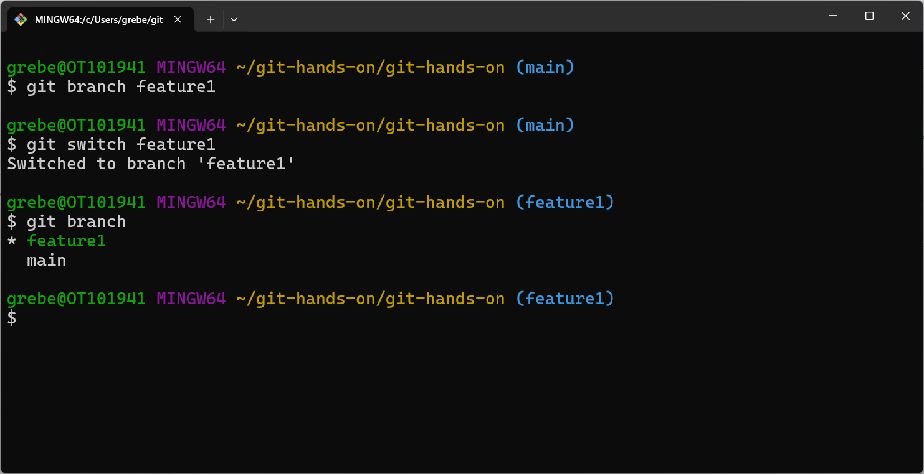
Create Feature1 Branch

Slide 50
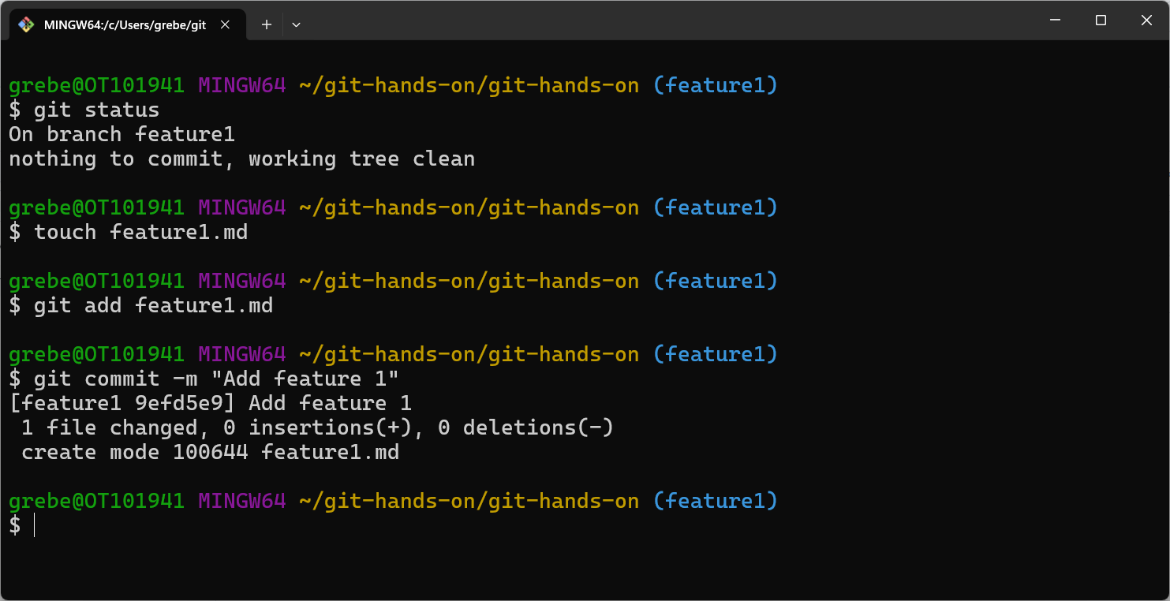
Add Feature 1 Changes

Slide 51
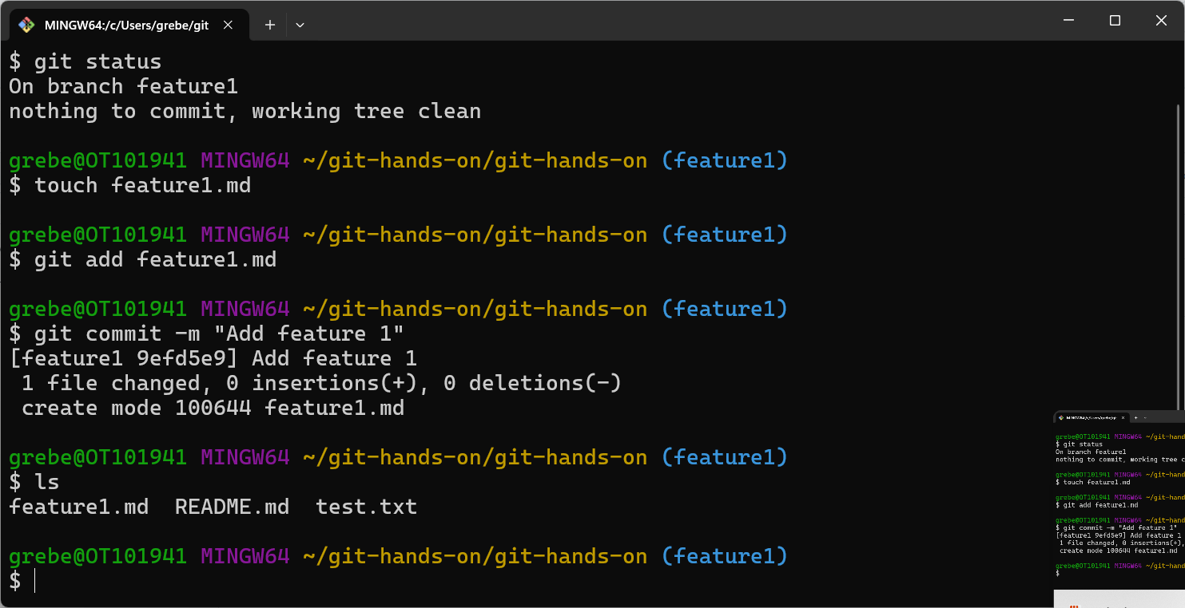
List Feature1 File

Slide 52
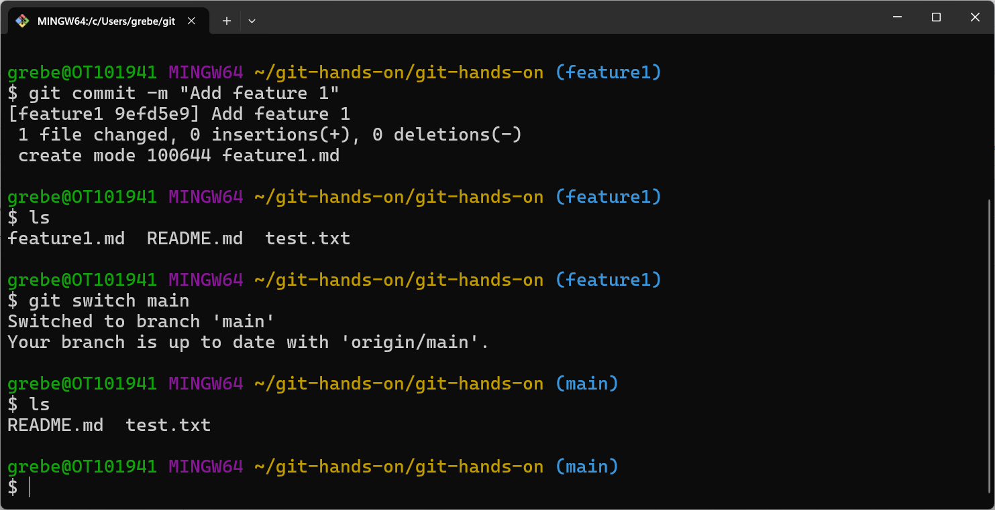
Back to Main Branch

Slide 53
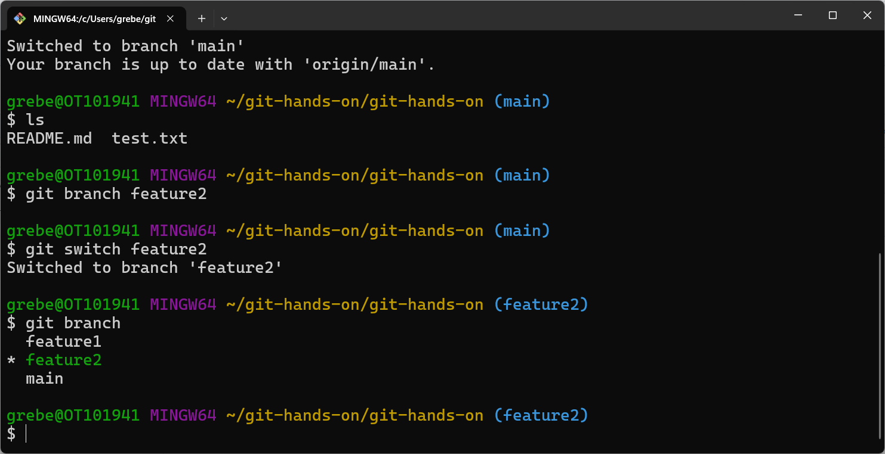
Create Feature2 Branch

Slide 54
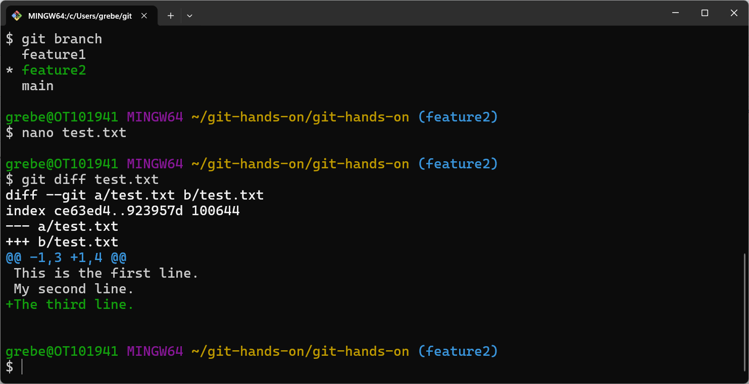
Edit File for Feature2/ Display Diffs

Slide 55
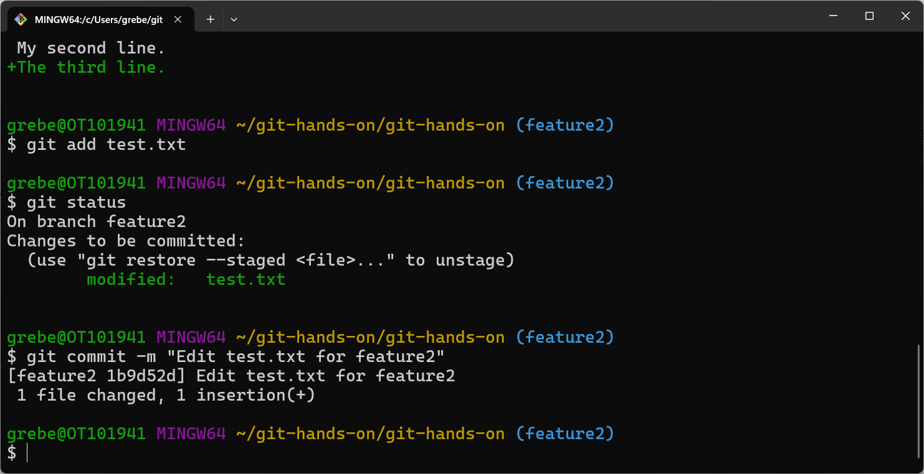
Add and Commit Feature2 Changes

Slide 56
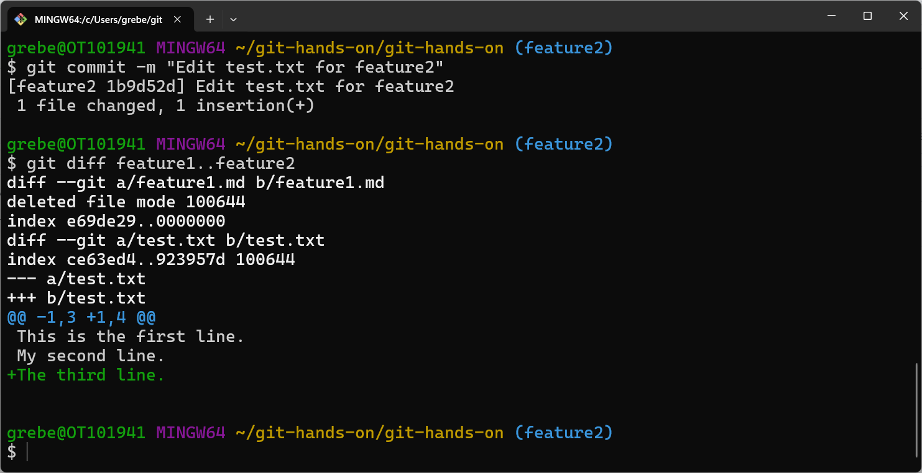
Diff Branches

Slide 57
Section 7
Working Remotely With Branches
Screenshots

Slide 58
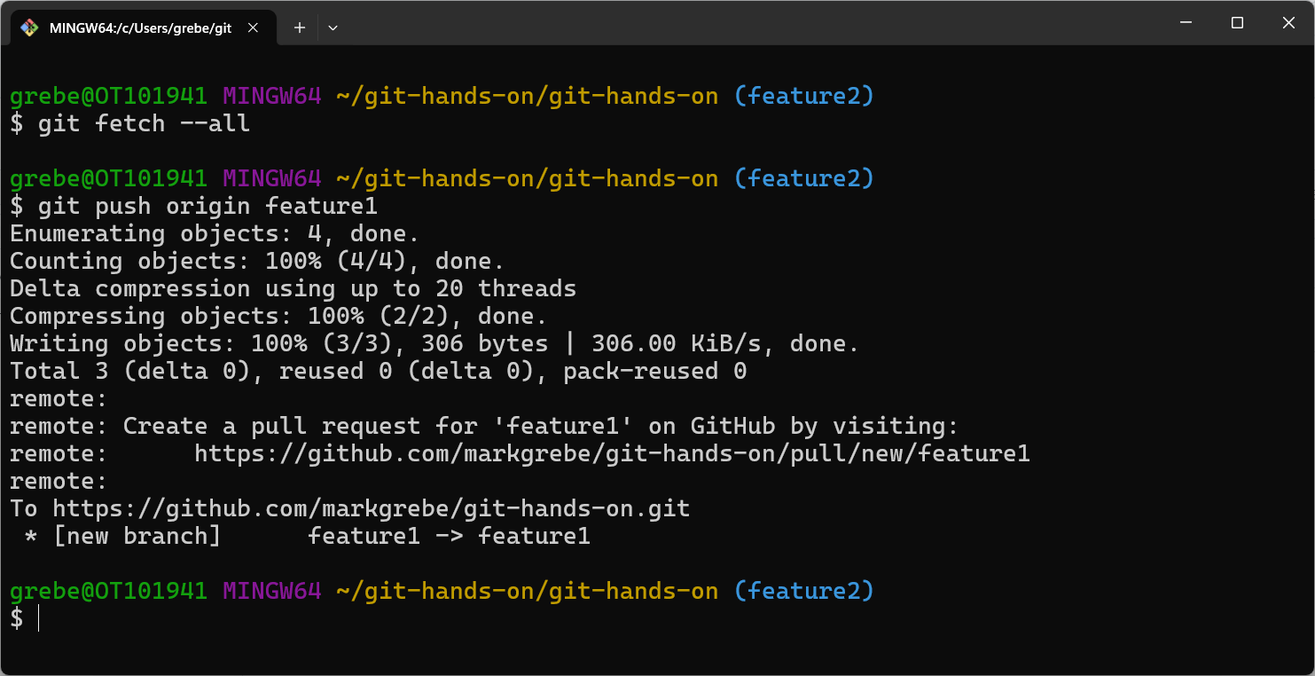
Push our Feature1 Changes

Slide 59
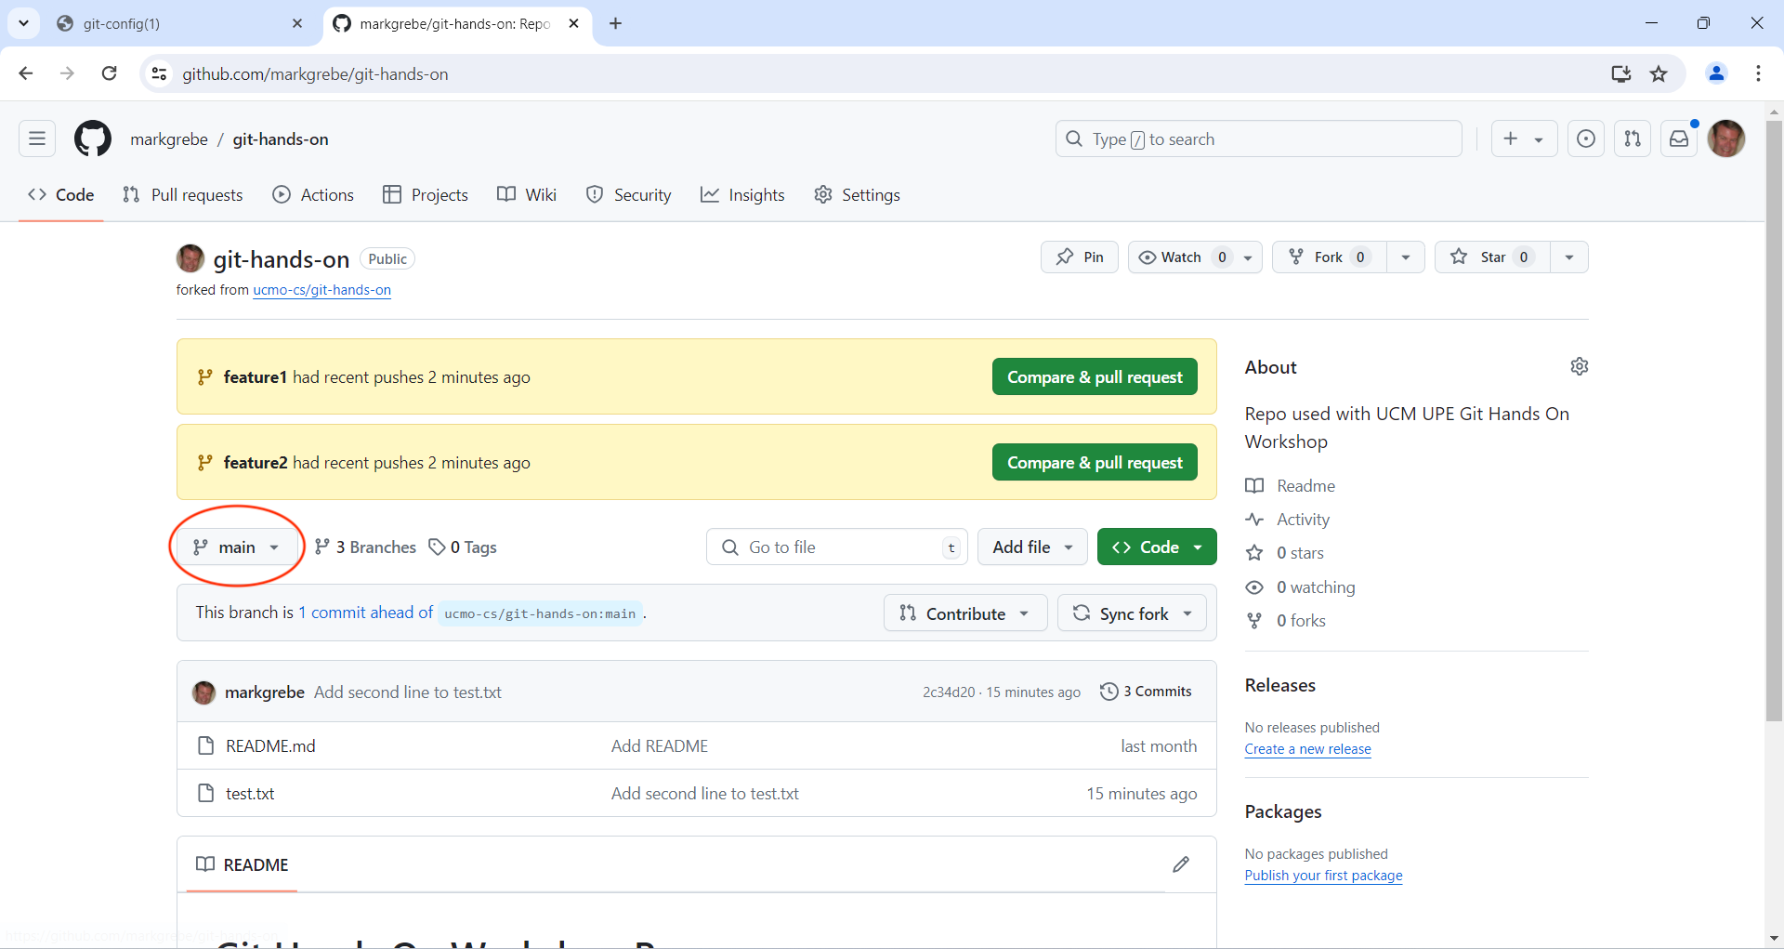
Switch Branches on Web

Slide 60
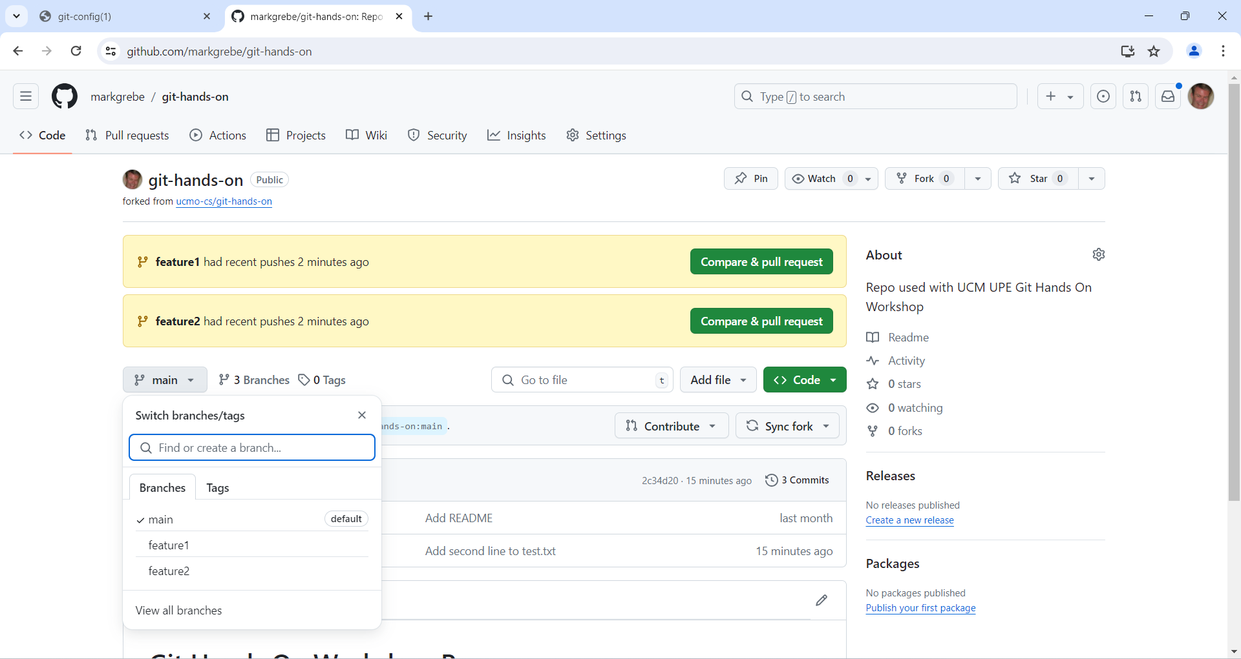
Now 3 Branches

Slide 61
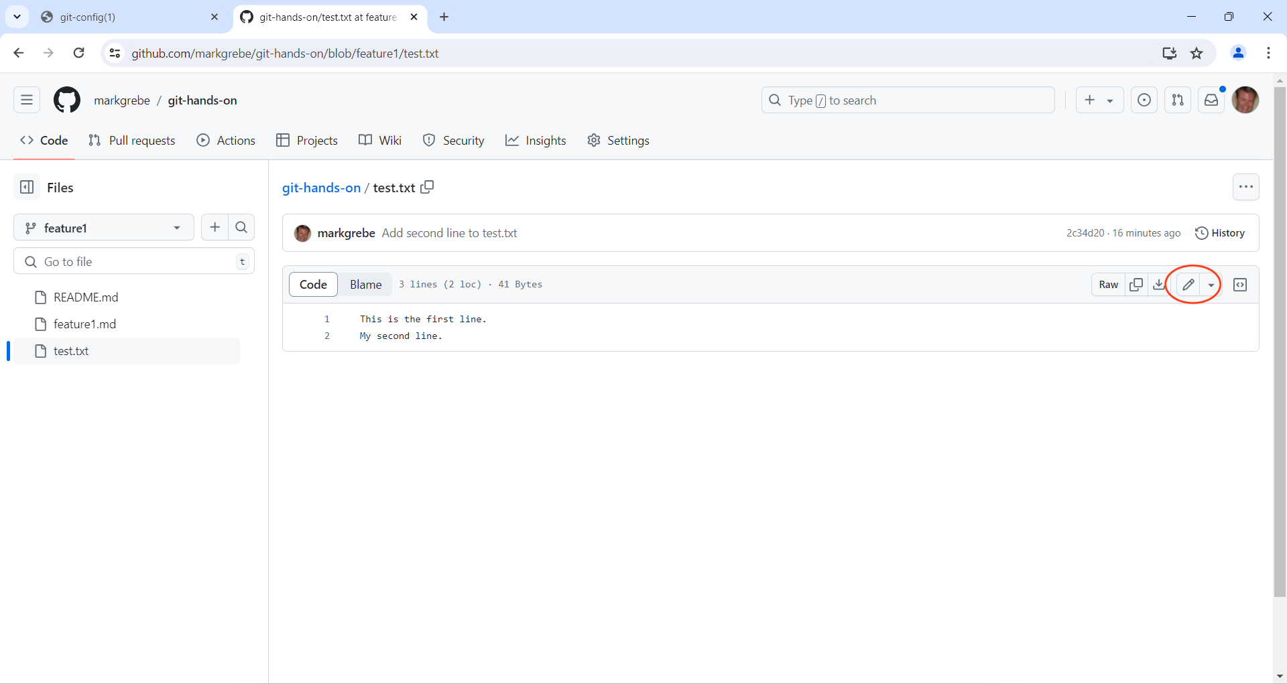
Edit Feature1 File on Web

Slide 62

Add Line and Commit

Slide 63

Commit Message

Slide 64

Get Changes From Remote

Slide 65
Section 8
Merging
Screenshots

Slide 66

Back To Main Branch

Slide 67

Change Local Main and Merge

Slide 68

Fix Merge Conflicts

Slide 69

Fixed Merge Conflicts

Slide 70

Finish Merge

Slide 71


